Slide 1
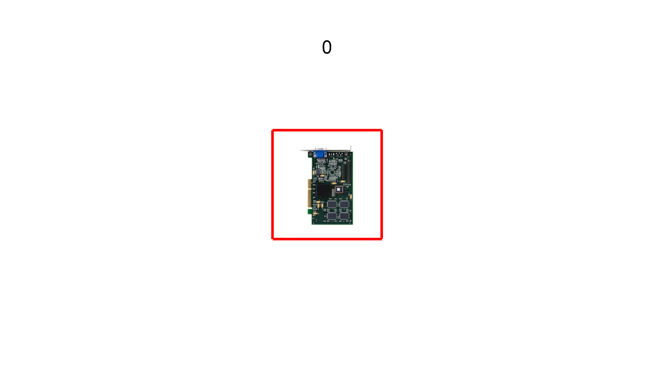
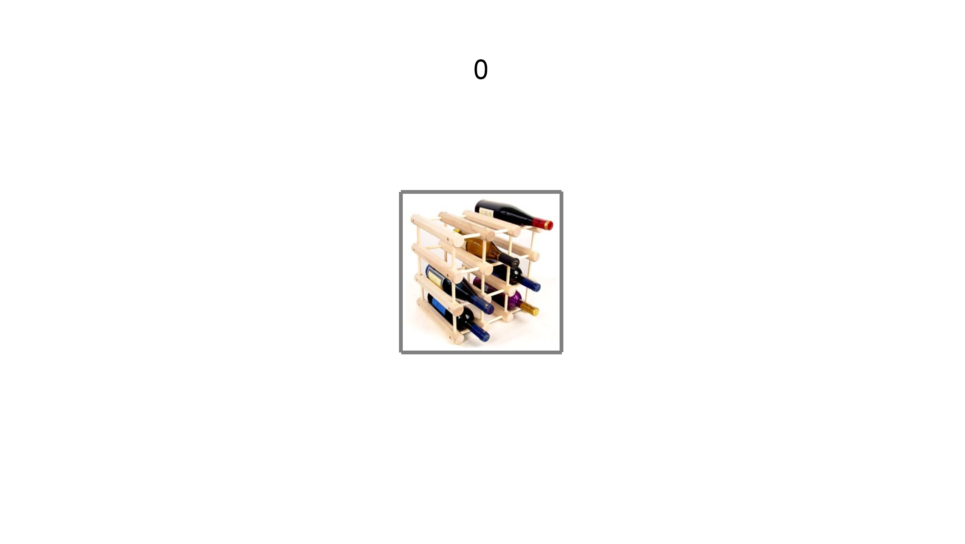
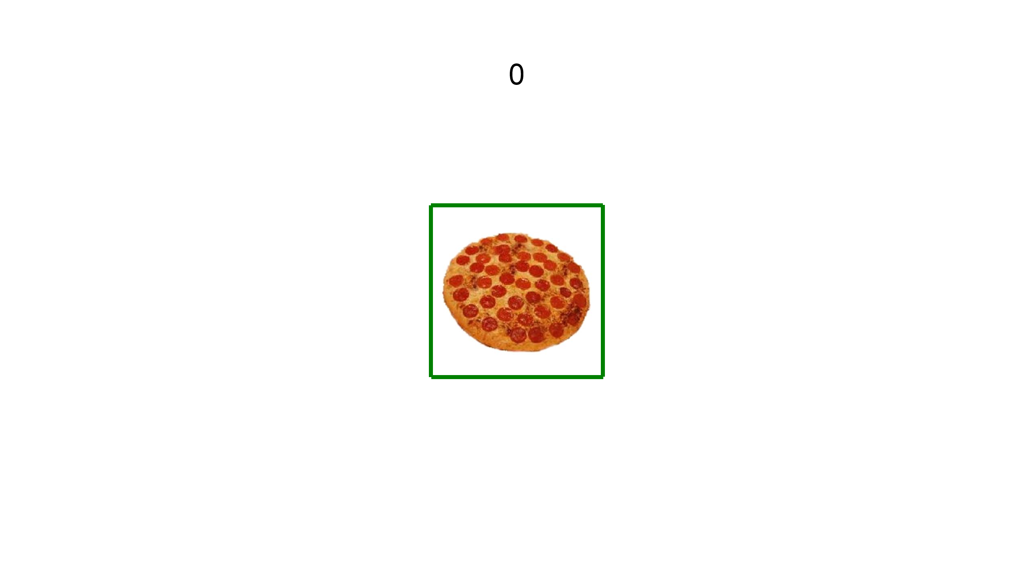
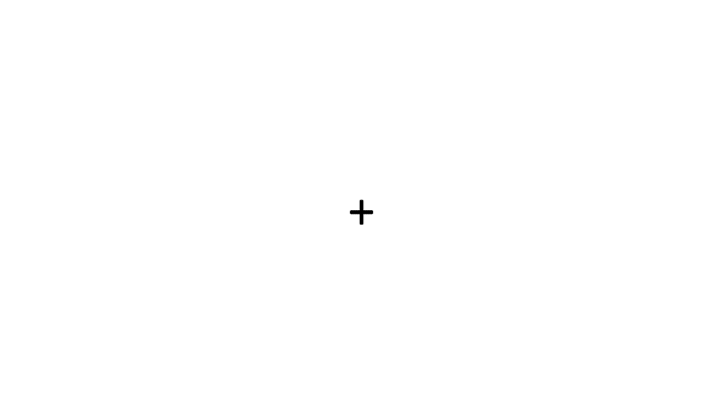
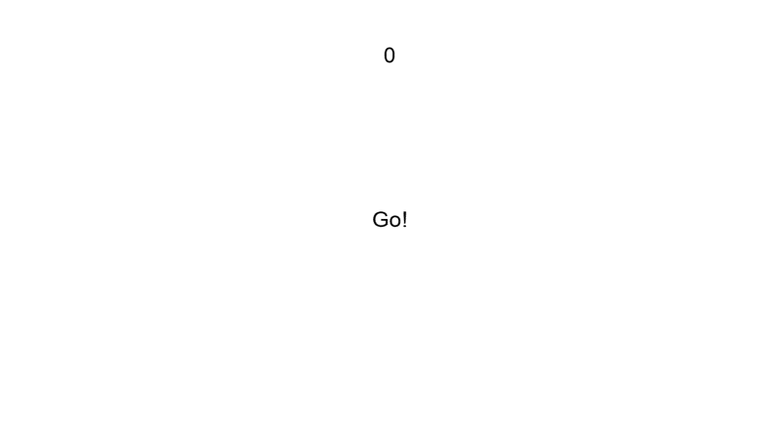
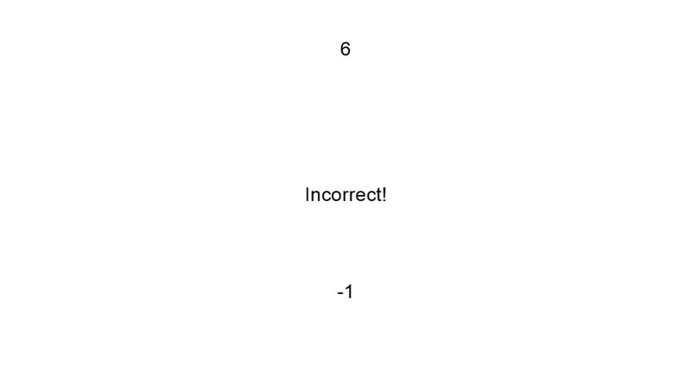
Lose
Maintain
Gain
Cue + Stimulus
2000ms
ISI
2000-6000ms
Response Window
500ms
ISI
2000-6000ms
Feedback
2000ms
ISI
2000-6000ms

Slide 2
+

